Slide 1
STRX
ATB VALIDATIOn
Detailed TS/TC review
Klara konikova
Apr, 2021

Slide 2
Overview
ATB Requirements specifications:
DC-ATB (15)
BIST-ADC (7)
HF buffer (7)
AC-ATB (27)
Safety (4)
Design Team
Michiel Hallie
IP owner
Hemant Bhasin (Blr – BL RFP)
RF buffer (incl. PPD)
Ref - BIST
Chandra Prakash (Blr – BL AA)
AC-ATB
DC-ATB
Anindita Roy Chowdhury (Blr – RFP)
top-level test-bench
Andreas Kannengiesser (Hbg – RFP)
Bronze DR:
https://www.collabnet.nxp.com/sf/go/doc494860?nav=1&pagenum=1&pagesize=15
ATB register map:
https://www.collabnet.nxp.com/sf/go/doc435009?nav=1&pagenum=1&pagesize=15

Slide 3
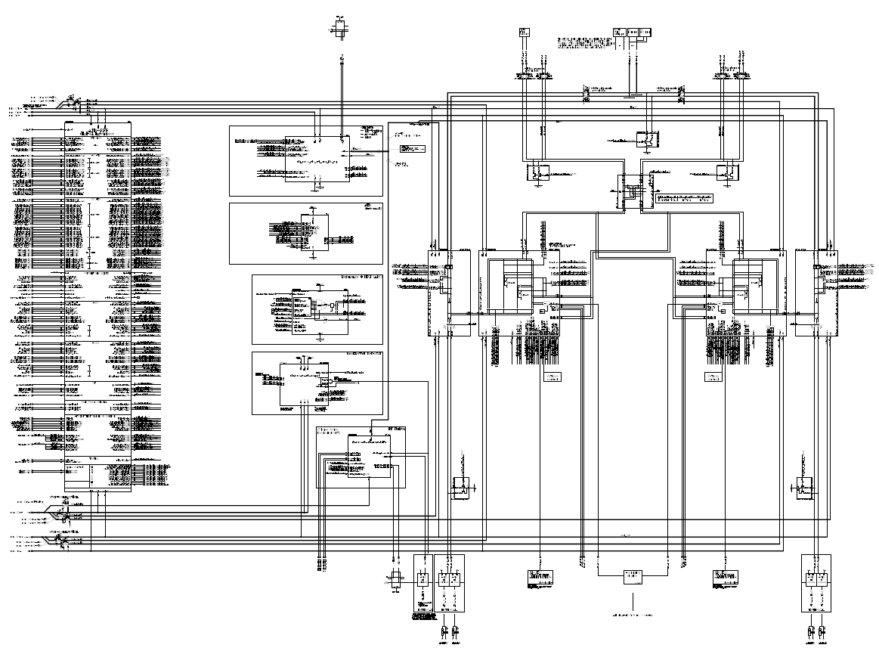
ATB-IP schematics (14/04/21)
ATB RFEDig Interface
Supply RF Buffer, AC-ATB, ppd
ATB int
AC-ATB1 master
DC-ATB1 master + ATB-ADC
DC-ATB2 master + ATB-ADC
AC-ATB2 master
Ref BIST + ADC
PPD
RF buffer

Slide 4
DC connexions

Slide 5
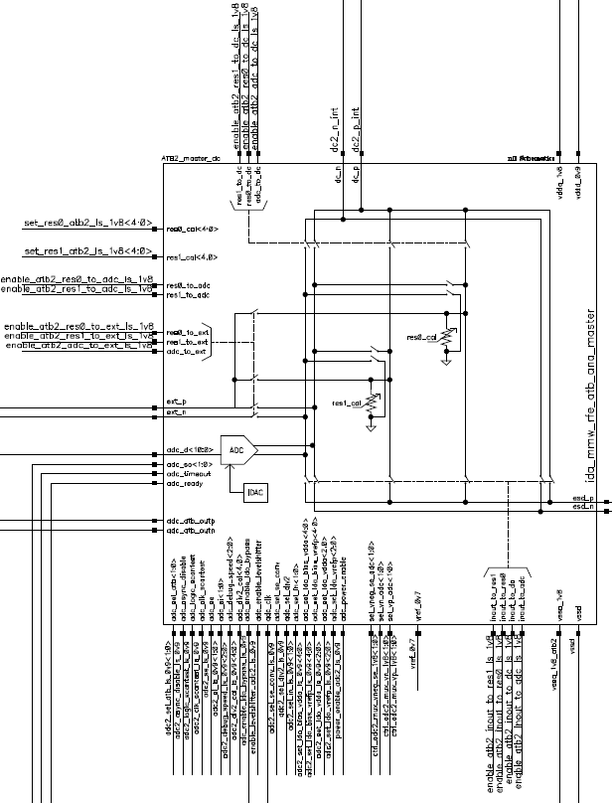
DC-ATB masterswitch schematics (14/4/21)

Slide 6
Power consumption DC on
Artifact Type | ID | Primary Text | Test Procedure | Pass/Fail | Comments
Characteristic | 1246579 | The leakage current of the ATB IP in DC OFF state at test supply shall be | Covered by TS 1246560 | < 100 uA | Cannot be discriminated from the GBIAS leakage current since they share the supply ball
Characteristic | 1133908 | The ATB IP DC ON current consumption (1.8V FuSA domain) (considering all internal ATB blocks are operating) shall be less than | - Init the DUT - Supply 1.8V FuSa with an external supply - Perform calibrations (including trimming) - Turn the ATB IP off - Measure the current on 1.8V supply - Repeat measurement with ATB IP on (+ADC) - Measure the current on 1.8V supply - Calculate the difference I_on-I_off | < 15 mA | at max power supply, max temperature Quiescent current
Characteristic | 1246560 | The ATB IP DC ON current consumption (1.45V GLDO domain) of the (all test buffers are enabled) shall be less than | - Init the DUT - Supply ATB IP via VDDA_GBIAS_1V45 with an external supply - Perform calibrations (including trimming) - Turn the ATB IP off - Measure the current on 1.45V supply - Repeat with ATB IP on (with IF and PN buffers, and ppd on) - Measure the current on 1.45V supply - Calculate the difference I_on-I_off | < 40 mA | IF analog buffer and HF PN test buffer activated
Meas. equipment:
-> no additional equipment needed

Slide 7
DC connections – dis-/connect, tristate…
Artifact Type | ID | Primary Text | Test Procedure | Pass/Fail | Comments
Requirement | 1207685 | [DfT-ATB] The ATB shall connect temperature sensor (TSENSE) to calibrate the sensor via voltage reference (lowest leakage) | - Init the DUT - Perform calibrations (including trimming) - Enable temp sensor IP - Connect temp sensor to ATB (ATB2_SEL @ob1, ATB1_SEL @0b1001) - Force a 1.25V through ATB1 - Read the voltage at ATB2 |  | enable voltage calibration of the tempsensor, it is strived for +/- 1.5 °C accuracy . Therefore very accurate voltage refrence from the industrial tester is required
Requirement | 1133898 | It shall be possible to disconnect (tri-state) the external ATB connections. | Covered by TS 1134471
Requirement | 1134469 | It shall be possible to (dis-)connect ATB2_DC to ATB2 (or pins DEBUG_ATB2P, DEBUG_ATB2N). | Covered by TS 1134471
Requirement | 1194399 | [DfT-ATB] The 4 ATB device pins shall be disconnectable from the ATB | Covered by TS 1134471
Requirement | 1134461 | It shall be possible to connect ATB2_DC to ground at ATB IP. | Covered by TS 1134471
Requirement | 1134476 | It shall be possible to connect ATB1_DC to ground at ATB IP. | Covered by TS 1134471
Requirement | 1134471 | It shall be possible to (dis-)connect ATB1_DC to ATB1 (or pins DEBUG_ATB1P, DEBUG_ATB1N). | - Init the DUT - Perform calibrations (including trimming) - Force a voltage on ATB1 (1V) and route the loopback to ATB2 - With a SMU force a voltage (990mV) and measure the current - Disconnect the ATB1 from ATB IP (switches on high impedance) and measure the current at ATB2 - Repeat for ATB1 and ATB2 switched - Ground the ATB1_DC (ATB_PULLDOWN register, field ENA_DC_PULLDOWN) - Force a small voltage (10mV) on ATB1 and read the current - Repeat for ATB2_DC
Requirement | 1306873 | It shall be possible to control the ATB IP and all the ATB SWs inside the RFE IPs via external SPI path (bypassing RFE CPU CTRL) for debug purposes | implicit validation after RFE validation covered by all the IP RS requesting ATB use
Requirement | 1134479 | The ATB_DC connections shall be bidirectional. | Implicit validation after RFE validation covered by all the IP RS requesting DC ATB use (e.g. RS 1134471)
Meas. equipment:
-> multimeter (*2)

Slide 8
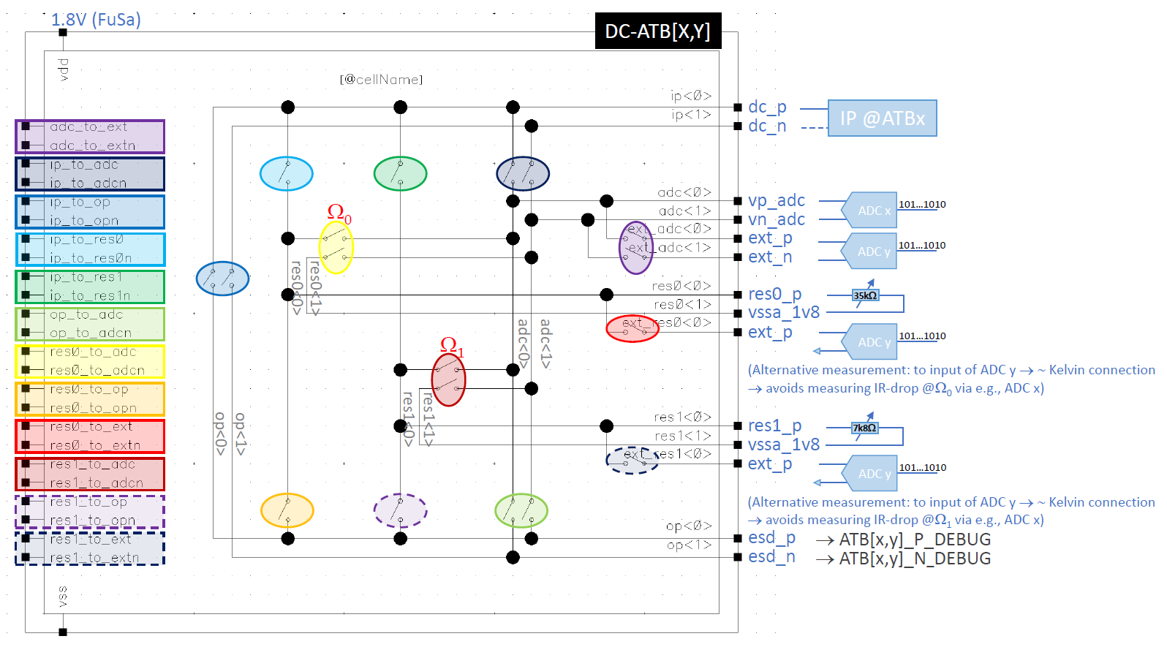



DC connections – trimmable resistors
Artifact Type | ID | Primary Text | Test Procedure | Pass/Fail | Comments
Requirement | 1194425 | [DfT-ATB] The ATB shall have a provision to connect the ATB primitives block to both ATB's. The ATB primitives block contains fixed and trimmable resistors. | implicit validation after RFE validation covered by all the IP RS requesting DC ATB use
Requirement | 1134549 | It shall be possible to force a current, supplied via the ATB balls, through a first trimmable reference resistor, such that the voltage over the resistor can be observed through the ATB. | - Init the DUT - Perform calibrations (including trimming) - Make connection through the first trimmable resistor (RS 1134549) - Force current (e.g. 50mA) through ATB1 pins - Read the voltage at ATB2 - Repeat for the second trimmable resistor (RS 1134542) | Read voltage corresponding to U=RI
Requirement | 1134542 | It shall be possible to force a current, supplied via the ATB balls, through a second trimmable reference resistor, such that the voltage over the resistor can be observed through the ATB. | Covered by 1134549
Meas. equipment:
-> precision power supply or SMU
-> multimeter
Current path
Measure voltage by connecting ext_p (close ext_res switch) to another ATB_P_DEBUG pin
Extra ground connections to be added

Slide 9
ATB-ADC (BIST ADC)

Slide 10
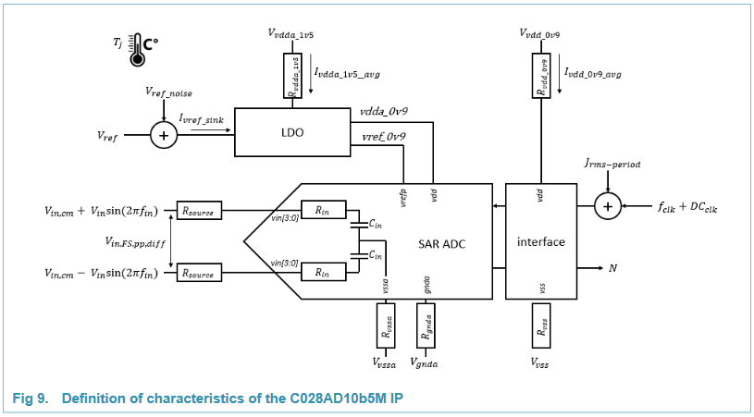
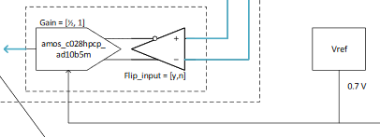
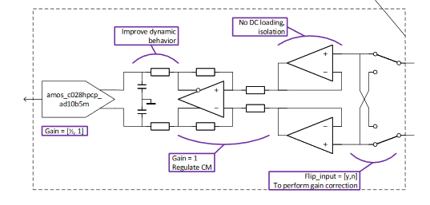
BIST ADC
11 bit diff input
10 bit se input
SE: 0V < p_input < 0.78V → 0.76mV resolution -20mV < n_input < 100mV
Diff:
Common mode: 0.45V
Typ 0.78V -> 0.38mV resolution
BIST ADC datasheet:
https://www.collabnet.nxp.com/sf/docman/do/downloadDocument/projects.smarttrx/docman.root.es0.011_ic_architecture_design_and_i.ip_design.ams_ips.bist_adc/doc421723

Slide 11
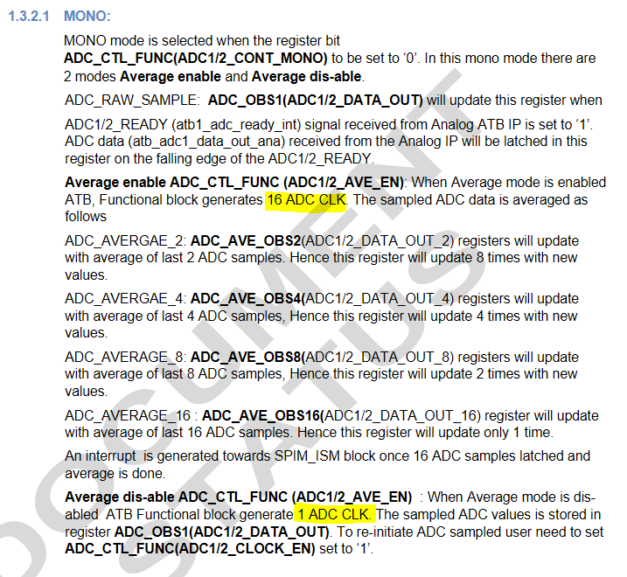
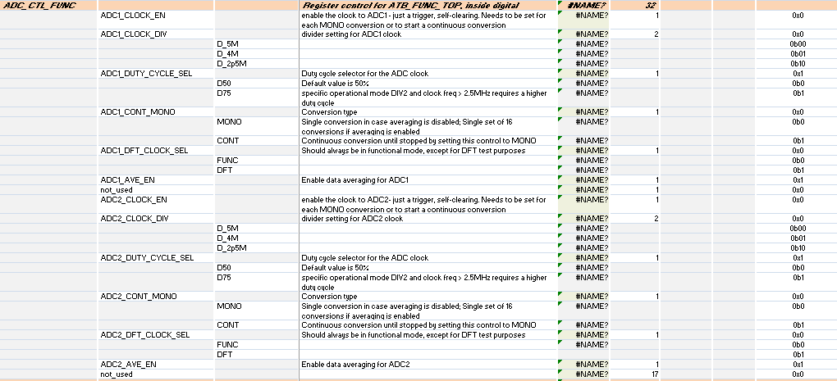
Freq. divider and data stream averaging
Artifact Type | ID | Primary Text | Test Procedure | Pass/Fail | Comments
Requirement | 1349535 | The ATB averaging function shall offer an enable or disable mode according to the measurement to be done | Covered by TS 1306822 |  | no need to average all DC voltages being measured. Need to have a 'bypass mode'.
Requirement | 1306822 | The ATB IP frequency divider shall offer a programmable division range to allow different BIST ADC clock frequencies (5MHz, 4MHz, 2.5MHz) | - Init the DUT - Perform calibrations (including trimming) - Connect BIST ADC clk to ATB - Set clk frequency to 2.5MHz (field ADC1_CLOCK_DIV and ADC2_CLOCK_DIV) (- Keep duty cycle at 50%) - Enable data averaging (ADC1/2_AVE_EN) for both ADCs - Trigger a single ADC capture for ATB-ADC1 - Observe the ADC clock with an oscilloscope (16 edges), measure ADC clock frequency - Repeat with a capture on ATB-ADC2 - Repeat with data averaging disabled (observe 1 clock edge) - Repeat for 4MHz, 5MHz
Clock can be routed to outside the circuit -> not clear yet on which pins (14/4/21)
Meas. equipment:
-> oscilloscope
Source: ATB Digital

Slide 12
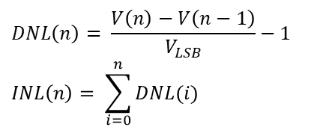
INL/DNL
Artifact Type | ID | Primary Text | Test Procedure | Pass/Fail | Comments
Characteristic | 1138623 | The DNL of the BIST-ADC for both differential and single-ended modes shall be | - Init the DUT - Perform calibrations (including trimming) - Set ATB-ADC to a single-ended conversion - Connect an external voltage source to ATB1 and sweep voltage from 0V to 780mV by 0.2mV step - At each step make n A/D conversion - Calculate DNL and INL - Repeat for ATB-ADC2 - Repeat for differential conversion | -1 LSB < DNL < +1 LSB
Characteristic | 1138624 | The INL of the BIST-ADC for both differential and single-ended modes shall be | Covered by TS 1138623 | -1 LSB < INL < +1 LSB
Meas. equipment:
-> precision power supply (*2)
$$DNL\left(n\right)= \frac{V\left(n\right)−V\left(n−1\right)}{V_{LSB}}−1$$
$$INL\left(n\right)= \sum_{i=0}^{n}{DNL(i)}$$

Slide 13
Ref voltages
Artifact Type | ID | Primary Text | Test Procedure | Pass/Fail | Comments
Characteristic | 1134535 | The BIST-ADC requires a bandgap reference voltage with value and accuracy of | - Init DUT - Perform calibrations (trimming) - Enable bandgap circuit (ENA_BG) - Connect the 0.7V bg reference to the ATB and measure voltage - register PVT_REF_GEN_BIST_0, field MUX_SEL @ 0b100 - register ATB_CTL1 field ATB1_SEL @ 0b00000101 (REF_BIST_VREF) (Keep possibility to modify PVT_REF_GEN_BIST_0, field TR_BG_SETDC) | 0.665V < V < 0.735V | Artf639876 The ATB is validated implicitely in measurements of other IP-blocks.
Requirement | 1134552 | The BIST-ADCs reference voltage shall be measurable outside the IC using the ATB pins. | Covered by TS 1194408
Requirement | 1194408 | [DfT-ATB] The BIST ADC reference Voltage needs to be measurable outside the IC. | - Init DUT - Perform calibrations (trimming) - Connect the 0.9V reference voltage to the ATB - register ATB_CTL1 field ATB1_SEL @ 0b00000110 (ADC2_VDDA_0V9) - register ATB_CTL1 field ATB2_SEL @ 0b00000010 (ADC1_VDDA_0V9) - Measure the voltage |  | For trimming, calibration
Meas. equipment:
-> multimeter (*2)

Slide 14
PN (HF) buffer

Slide 15
Clock PLL = MCGen clk
p/n
ChirpPLL

Slide 16
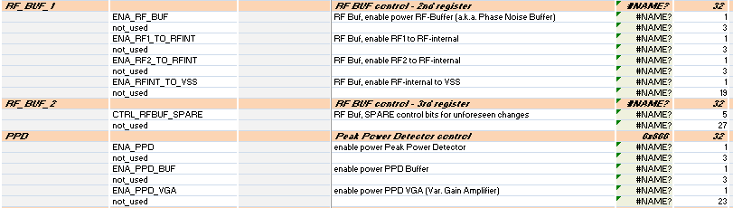
ATB HF buffer
Artifact Type | ID | Primary Text | Test Procedure | Pass/Fail | Comments
Requirement | 1134523 | It shall be possible to ground the ATB inputs relative to the MasterClock Generator signals inside the ATB IP. | ENA_RFINT_TO_VSS not connected, grounding in ATB IP impossible -> this RS is to be removed
Requirement | 1398820 | When signal is injected from external (tester) at PLL_PN test pin, for PPD characterisation, the HF buffer shall be high impedance mode (attenuation of PLL signal by more than 25dB) | - Init the DUT - Perform calibrations (including trimming) - Keep PN buffers disabled (register RF_BUF_1 field ENA_RF_BUF) and enable ppd (register PPD field ENA_PPD) - Calibrate the ppd - Inject a known signal on the PN buffer pin - Make measurement with ppd (value PPD_VO_PEAK on fields ATB1_SEL or ATB2_SEL)
Meas. equipment:
-> IF generator (single-ended)

Slide 17
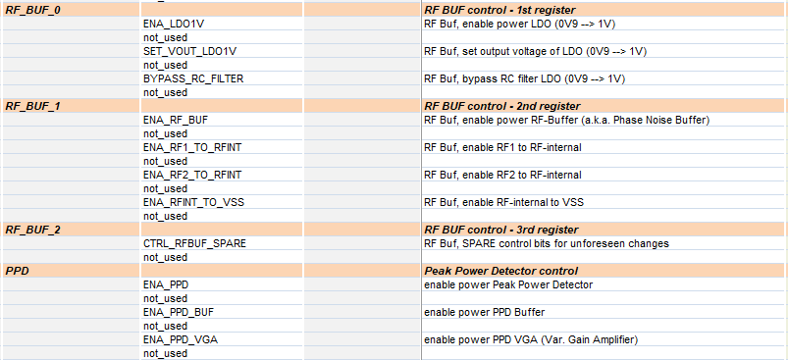
ATB HF buffer
Artifact Type | ID | Primary Text | Test Procedure | Pass/Fail | Comments
Characteristic | 1244676 | The HF buffer for PN test shall operate in the range | Covered by TS 1246545 | 0.32 < x < 6 GHz (5 GHz typ.)
Characteristic | 1246534 | The HF buffer for PN test output power shall be in the range | Covered by TS 1246545 | -8 < x < 6 dBm (0 dBm typ.)
Requirement | 1308690 | It shall be possible to connect the ChirpPLL divided output (around 5GHz) to the ATB PN TEST mux inside ATB IP | Covered by TS 1246545
Requirement | 1233199 | ATB IP shall offer a high frequency (HF) buffer to drive external PN test pin and 50ohms equipement | Implicit validation Covered by TS 1246545
Characteristic | 1246584 | The HF buffer current consumption shall be less than | Covered by TS 1246545 | < 25 mA | ATB powered through VDDA_GBIAS_1V45 (shared with GBIAS)
Requirement | 1246545 | The HF buffer for PN test shall (integrate a mux at its input to) allow selecting between one of the two different inputs (clkPLL, chirpPLL) that will be measured | - Init the DUT - Power ATB directly through pin VDDA_GBIAS_1V45 with an external supply - Perform calibrations (including trimming), enable ATB IP - Keep buffer LDO disabled - Measure ATB power consumption (i_off) - Start clkPLL and chirpPLL - Connect clkPLL to ATB PN TEST - Measure power and observe the signal (with a spectrum) on the PN buffer output and the output power (pwm) for the n - Repeat for p - Measure ATB power consumption (i_on) - Repeat for chirp PLL (only p – single ended) |  | To connect the clkPLL: ATB IP regmap RF_BUF_1 register ENA_RF1_TO_RFINT @1 ENA_RF2_TO_RFINT @0 in clk_adpll regmap ENA_RF_TEST_BUF in ENABLE_LDO register To connect the clkPLL: - chirpPLL regmap ENABLE_DIV2 in ANA_MISC_CTL register
25 mA for each buffer
Meas. equipment:
-> spectrum analyzer

Slide 18
AC-ATB (not RX IF)

Slide 19
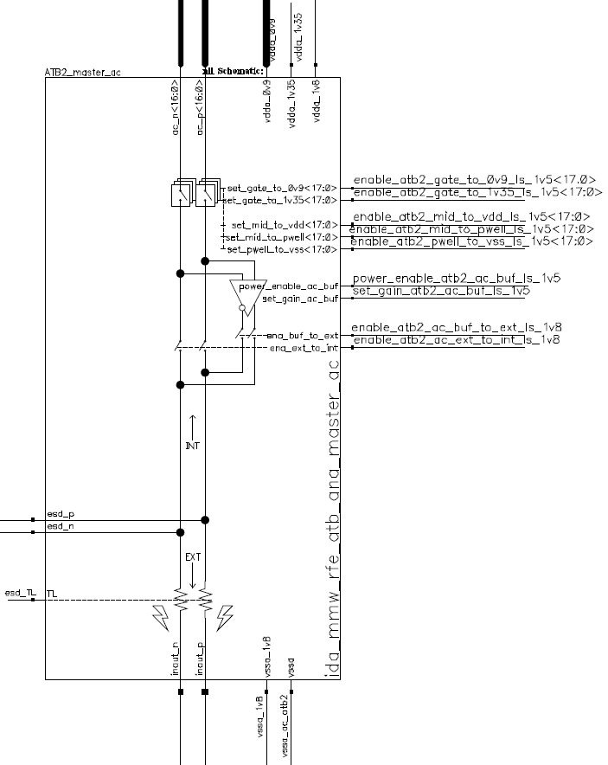
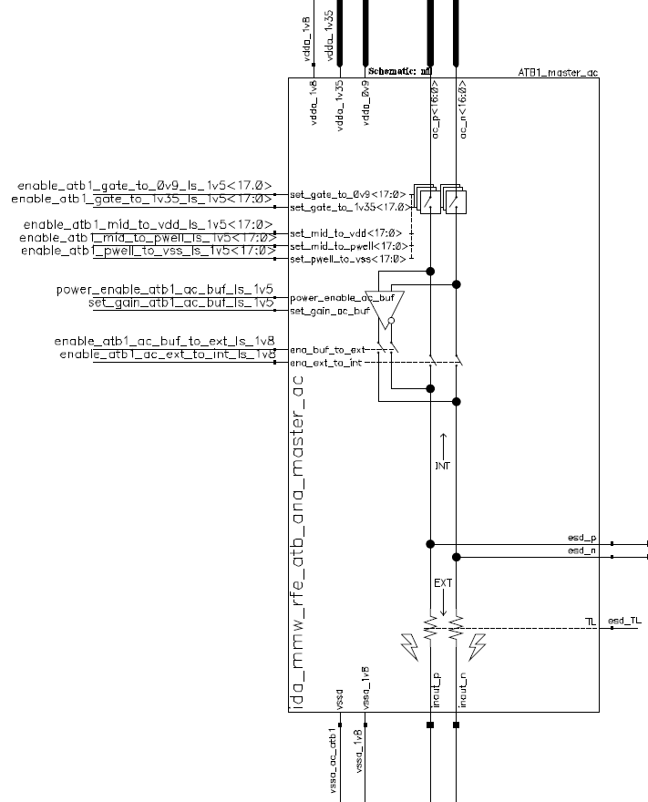
AC-ATB masterswitch schematics

Slide 20

AC-ATB connections
Bench
Artifact Type | ID | Primary Text | Test Procedure | Pass/Fail | Comments
Requirement | 1134516 | The ATB IP shall support the possibility to monitor the VCO Vtune voltage (ChirpGen IP) via the ATB. Because of the sensitivity of the VCO Vtune signal a separate ATB connection for the Chirp IP shall be used (can not share DC bus with other IPs) | - Init the DUT - Perform calibrations (including trimming) - Turn on VCO-PLL - Connect VCO Vtune to AC ATB2 (ChirpPLL RegMap, register ATB_AC, field CHIRP_VTUNE_SEL) - Measure voltage
Requirement | 1134521 | It shall be possible to connect the dedicated ATB connection from the ChirpPLL IP to ATB2. | Covered by RS 1134516 |  | Dedicated ATB connection from the ChirpPLL = Vtune
Cannot check for the separate connection
Meas. equipment:
-> multimeter

Slide 21
AC-ATB (RX IF)

Slide 22
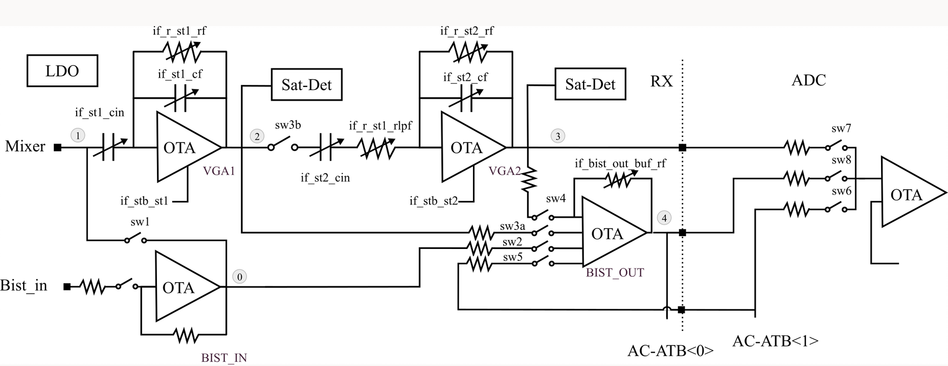
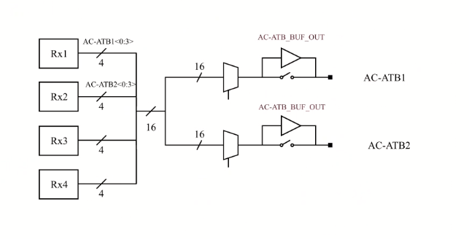
RX with IFBIST diagram
RX1..4
Q
I
IF BIST Q
IF BIST I

Slide 23
AC-ATB connections (RX loopback)
Artifact Type | ID | Primary Text | Test Procedure | Pass/Fail | Comments
Requirement | 1134466 | The ATB_AC connections shall be bidirectional. | Covered by TS 1308810 & 1308702
Requirement | 1308700 | It shall be possible to connect I and Q output signal of each of the receiver to the AC_ATB bus | Covered by TS 1308810 (AC-ATB IRR)
Requirement | 1308705 | It shall be possible to inject a differential IF signal at one AC_ATB access , send it to a receiver node, and read it back with another AC_ATB2 access | Covered by TS 1308702 |  | 200kHz to 40MHz, small signal to de-embed test path
Requirement | 1308706 | It shall be possible to inject a differential IF signal at AC_ATB pins and make it available at all the receivers IF nodes simultaneously (broadcast mode) | Covered by TS 1308702
Requirement | 1320789 | It shall be possible to inject an IF signal at one AC_ATB access , send it to any ADC input, and read it back with the other AC_ATB2 access | Covered by TS 1308702
Requirement | 1308702 | It shall be possible to inject a differential IF signal from ATB external pins to each of the receiver's IF inputs or nodes | - Init DUT - Perform calibrations (including trimming) - Inject a differential IF signal of 200kHz to 40MHz (small signal) on ATB2 - Route the signal via RX1 I BIST_OUT (RS 1308702) and loopback to ATB1 (RS 1308705) - Make an ADC capture (API) of RX1 and observe the signal on ATB1 - Repeat for Q - Repeat for RX 2-4 | observe a signal at the given frequency | 200kHz to 40MHz, small signal
Meas. equipment:
-> Differential IF generator
-> Oscilloscope (RTO/RTP)
ADC regmap: register SEL_MUX_IN -> field SEL_MUX_ADC_IN_I or Q -> 1 (test input)
8 lines/RX (I and Q)
16 lines n + 16 lines p
RX regmap: register IF_A -> field SW_BIST_LOOPBACK (sw5)
diff.

Slide 24
AC-ATB connection towards ADC
Artifact Type | ID | Primary Text | Test Procedure | Pass/Fail | Comments
Requirement | 1320788 | It shall be possible to inject an IF signal from ATB external pin to each of the ADC IP inputs | Covered by TS 1320790
Requirement | 1320790 | It shall be possible to inject an IF signal from AC_ATB pins at all the ADCs inputs simultaneously (broadcast mode) | - Init DUT - Perform calibrations (including trimming) - Inject a differential IF signal of 200kHz to 40MHz (small signal) on ATB1 - Route the signal to ADC1 - Make an ADC1 capture (API) - Repeat for ADC2 - Repeat with a signal routed to both ADCs simultaneously (RS 1320788)
Meas. equipment:
-> Differential IF generator
ADC regmap: register SEL_MUX_IN -> field SEL_MUX_ADC_IN_I or Q -> 2 (AC_ATB input)
diff.

Slide 25
AC-ATB – AC characteristics (oip3)
Artifact Type | ID | Primary Text | Test Procedure | Pass/Fail | Comments
Characteristic | 1308712 | The linearity (oip3) of the signal path from the RX outputs to the ATB IP outputs shall be better than | - Init the DUT - Perform calibrations (trimming) - Inject two differential signals at -13dBm, F1=4*f, F2=4.4*f, f=200kHz on AC-ATB1 - Loopback through BIST_OUT buffer - Route to AC-ATB2 through IF buffer - With RTO/RTP (+VSE) measure the 3rd order intermodulation signals power (dB) OIP3 = P1 + (P1 + P3)/2, P1 being the first order output power, P3 the 3rd order output power - Repeat for f=400kHz, 800KHz, 1.6MHz, 3.2MHz. | OIP3 > 17dB | perf needed for ATB buffer to measure RX in-band linearity 2 input tones at -13dBm (-56dBm + 43dB RX CG gain), F1=4xHPF, F2=4.4xHPF, HPF=200kHz, 400kHz, 800KHz, 1.6MHz, 3.2MHz.
Meas. equipment:
-> 2 differential IF generators
-> -> Oscilloscope (RTO/RTP + VSE)
750mVpp diff max due to the IF buffer lin.
RX regmap: register IF_A -> field SW_BIST_LOOPBACK (sw5)

Slide 26
AC-ATB – AC characteristics (irr)
Artifact Type | ID | Primary Text | Test Procedure | Pass/Fail | Comments
Characteristic | 1308810 | The image rejection ratio (IRR) between I & Q signals path from a receiver output to the ATB output shall be | - Init the DUT - Perform calibrations - Enable IF BIST and inject a differential IQ signal (1.2 Vpp) at 200kHz to 40MHz (SSB modulator) - Route the signal via BIST_OUT buffer to AC-ATB1 (I) and AC-ATB2 (Q), through IF buffers - With RTO/RTP (+VSE) measure the I/Q IRR - Repeat for RX2-4 | IRR > 40dB | to be able to measure externally the image rejection of IQ receiver pvt, 1.2Vpp diff (all path, ATB SWs, muxes, IF buffer + load condition). MC simulations.
Meas. equipment:
-> Oscilloscope RTO/RTP (+VSE)

Slide 27
AC-ATB – AC characteristics (noise floor)
Artifact Type | ID | Primary Text | Test Procedure | Pass/Fail | Comments
Characteristic | 1189406 | The equivalent Noise Floor of the AC_ATB at the IF output / ATB input interface shall be | - Init DUT - Perform calibrations (including DC trim) - Terminate the RX1 path with 50 ohm load - Enable RX1, set the receiver in the configuration with the lowest noise (lowest gain,…) - Enable LO - Close the switch 4 (see diagram) - Connect RX1 BB I to AC-ATB through BIST_OUT, with going through IF buffer - Connect the n and p paths to a RTO/RTP (+ VSE) - Measure noise floor - Repeat for Q path - Repeat for RX 2-4 Expected results: difficulty to measure - Cannot be measured separately from the RX noise | Noise floor < -140dBm/Hz | Required to enable measurement of the RX Noise Floor at the analog output of the IF signal chain. Assumed RX NF in I or Q= 14dB (12dB after Hilber Filter) Conversion Gain = 40dB Noise Level = -174 + 40 + 14 = -120dBm/Hz Margin = 20dB, measurement error = 0.04dB
IF buffer gain: 1, 1/3
Meas. equipment:
-> RTO/RTP + VSE

Slide 28
AC-ATB - AC characteristics (gain flatness, gain & phase diff, BW)
Artifact Type | ID | Primary Text | Test Procedure | Pass/Fail | Comments
Characteristic | 1344146 | The AC_ATB connections from the RX output shall have a gain flatness over the IF frequency band (0.02-40MHz) with an accuracy of | - Init the DUT - Perform calibrations (including trimming) - Inject a differential signal of 20kHz on AC ATB1 750mV pp diff max - Loopback the signal through RX1 I BIST_OUT to AC ATB2, route through IF buffer - Measure the IF input and output power, calculate the Gain = P_out - P_in - Repeat through 200kHz-40MHz (100kHz, 200kHz, 500kHz, 1MHz, 2MHz, 5MHz, 10MHz, 20MHz, 40MHz) - Repeat for RX1-Q - Repeat for RX2, RX3, RX4 | -0.25 dB < x < 0.25 dB | required accuraccy to measure externally signals generated by BIST IP IF from 200kHz to 40MHz (PVT)
Characteristic | 1344147 | The gain difference between all the different RX AC_ATB paths to the ATB outputs shall be | - Covered by TS 1344148 | delta_G < 0.1dB for all IF frequencies, all RX, I and Q | required accuraccy to measure externally signals generated by BIST IP
Characteristic | 1344148 | The phase difference between all the different RX AC_ATB paths to the ATB outputs shall be | - Init the DUT - Perform calibrations (including trimming) - Inject a differential signal at 200kHz on AC ATB1 - Loopback the signal through RX1 I BIST_OUT to AC ATB2 - Connect the input and the output signal to an oscilloscope in order to measure the phase difference (n and p) - Repeat to cover the band 200kHz-40MHz - Repeat for RX1 Q - Repeat for RX2, RX3, RX4 | all the phase differences have to be < 1°
Characteristic | 1134492 | The bandwidth (-3dB) of the AC_ATB path between the IC balls and the IF output of the connected receiver (RX1...RX4) shall be | - Init the DUT - Perform calibrations (including trimming) - Inject a differential 1 MHz signal - Loopback the signal on the ATB1, without going through the IF buffer - Measure the output power in order to calculate the ratio Pin/Pout - Repeat until Pout(0dB)/Pout > 6dB - Expected result: not expect to find 60MHz (loopback) | > 60 MHz | required accuraccy to measure externally signals generated by BIST IP IF from 200kHz to 40MHz (PVT)
Calibration of the external path? -> input losses = output losses (assumption)
Gain = 0dB
Meas. equipment:
-> Differential IF generator
-> RTO/RTP
RX regmap: register IF_A -> field SW_BIST_LOOPBACK (sw5)

Slide 29
AC-ATB (RX IF) buffers
Artifact Type | ID | Primary Text | Test Procedure | Pass/Fail | Comments
Characteristic | 1308893 | The IF analog buffer input voltage shall be | Maximum level by simulation is 750mVpp diff Covered by 1309100 | < 1.2 Vpp diff | No danger of damaging IF bufffer by applying higher levels
Requirement | 1233198 | ATB IP shall offer an IF analog buffer to drive an external IF load | Implicit validation Covered by TS 1309100
Characteristic | 1242829 | The IF analog test buffer shall present a broadband behaviour (-3dB cutoff) such to not degrade transfer function of RX blocks being measured of | Covered by TS 1309100 | 60 MHz | to be able to caracterize all IF freq range (up to 40MHz).
Characteristic | 1246587 | The IF buffer current consumption shall be less than | Covered by TS 1309100 | < 25mA
Characteristic | 1309100 | The IF analog buffer shall have a compression point higher than | - Init the DUT - Perform calibrations (including trimming) - Inject a differential 20kHz signal on ATB2 (100mVpp) - Loopback the signal on the ATB1 (direct loopback, not through RX) - Measure the output signal power and calculate the ratio Pout(buffer)/Pout(direct path) - Repeat for Vin = 200mVpp, 400mVpp, 500mVpp, [550mV;650mVpp;10mV] to get P1dB - Repeat for 100kHz, 200kHz, 500kHz, 1MHz, 5MHz, 10MHz, 20MHz and 40MHz (RS 1309100) - At each step measure current consumption on the 1.45V supply - Disable the analog buffer (route the signal to the outside through direct path) and measure current consumption on the 1.45V supply - Calculate the current difference (RS 1246587) - Using loopback, inject a 1 MHz 100mVpp signal (linear zone) - Measure the output power in order to calculate the ratio Pout/Pout - Repeat for [36MHz; 66MHz; 2MHz] (RS 1242829) | > 0dBm
Impedance: 3kohm
Direct loopback (not through RX)
change
Meas. equipment:
-> Differential IF generator
-> RTO/RTP

Slide 30
AC-ATB (RX IF) buffers
Artifact Type | ID | Primary Text | Test Procedure | Pass/Fail | Comments
Requirement | 1309094 | It shall be possible to select between which ATB Buffer (Buf1 or Buf2) to use together with any of the receiver channels | Covered by TS 1344146
Characteristic | 1308945 | The isolation between two IF analog buffers shall be | - Init the DUT - Perform calibrations (including trimming) - From the ssb modulator inject a 100kHz differential signal and route it to AC-ATB1 through IF buffer (750mVpp diff – max linear input) - Enable and ground AC-ATB2 and connect through IF buffer - Measure power on ATB1 & ATB2, the difference should be >40dB - Repeat with ATB1 and ATB2 switched - Repeat for 500kHz, 1MHz, 5MHz, 10MHz, 20MHz, 30MHz, 40MHz | > 40dB isolation | in order to measure RX mixer IQ image rejection via external mode
Characteristic | 1308889 | The IF analog buffer shall have a linearity (IM3) better than | - Init the DUT - Perform calibrations (including trimming) - Inject 2 differential tones (750mVpp diff) on ATB2 at F1=4xf, F2=4.4xf, f=200kHz - Loopback the signal on the ATB1 - Measure the 3rd order intermodulation signals power (dBc) - Repeat for f=400kHz, 800KHz, 1.6MHz, 3.2MHz | > 73dBc | fully loaded (ext load), input at 1.2Vpp_diff, PVT, all parasitics take into account
Requirement | 1309095 | The IF analog buffer shall offer a bypass mode while presenting a high input impedance (>1MOhm) | - Init the DUT - Perform calibrations (including trimming) - Disable both IF buffers - Keep open switches on ATB1, measure impedance (between n and p) on ATB2 - Keep open switches on ATB2, measure impedance (between n and p) on ATB1 |  | to make possible to disable it and do not influence internal AC measurement (via BIST ADC)
Characteristic | 1244624 | Each IF analog test buffer shall be able to drive an external load SAMTEC twin-axial 20cm cable and AD8130 | Implicit validation Covered by all the TS ATB (all the measurements done with this setup)
Meas. equipment:
-> Differential IF generator *2
-> RTO/RTP (+VSE)

Slide 31
Safety

Slide 32
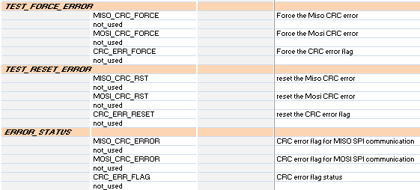
Safety
Artifact Type | ID | Primary Text | Test Procedure | Pass/Fail | Comments
Requirement | 1286767 | It shall be possible to force an error (positive asserted) at digital interface to check for its functionality (Force_Error) | - Initialize the DUT - Enable ATB IP - Reset all ATB error registers - Assert Force_error bit BBD_FORCE_ERR_HI - Read Error_Flag_N bit (should be asserted) - Assert Reset_error bit - Read Error_Flag_N (should not be asserted) - Repeat for MISO_CRC_FORCE, MOSI_CRC_FORCE, CRC_ERR_FORCE | Error_Flag_N bit should be asserted then deasserted
Requirement | 1286769 | The latched error flag of the ATB IP shall remain in its asserted state until the Reset_Error (positive asserted) interface clears it. | Covered by 1286767
Requirement | 1286770 | Any safety monitor of the ATB IP reporting into the ISM shall assert and latch the Error_Flag_N (negative asserted) line when a fault condition is observed. | Covered by 1286767 | Error_Flag_N should be asserted
Requirement | 1222143 | The ATB IP shall offer the capability to self test the safety check path of all ADCs and switches (fault injection) | Implicit validation (safety monitor and all the paths are implcitely validated) |  | To emulate a fault in the path (safety mechanism check), comply with fault injection
No specific measurement equipment needed
Measurement done by register reading/writing
¹PinPad list: https://www.collabnet.nxp.com/sf/go/doc419869

